Slide 1
Security in Computing, Fifth Edition
Chapter 2: Toolbox: Authentication, Access Control, and Cryptography

Slide 2
Objectives for Chapter 2
Survey authentication mechanisms
List available access control implementation options
Explain the problems encryption is designed to solve
Understand the various categories of encryption tools as well as the strengths, weaknesses, and applications of each
Learn about certificates and certificate authorities

Slide 3
Authentication
The act of proving that a user is who she says she is
Methods:
Something the user knows
Something the user is
Something user has

Slide 4
Something You Know
Passwords
Security questions
Attacks on “something you know”:
Dictionary attacks
Inferring likely passwords/answers
Guessing
Defeating concealment
Exhaustive or brute-force attack
Rainbow tables

Slide 5
Distribution of Password Types
Notes:
Alhough this data is from an old study, more recent studies have reaffirmed the results. The vast majority of passwords used on the Internet are extremely easy to crack.

Slide 6
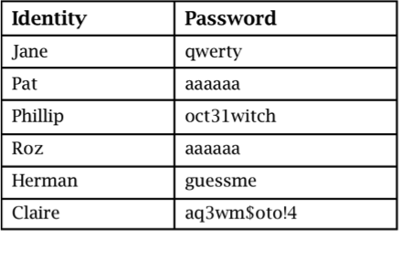
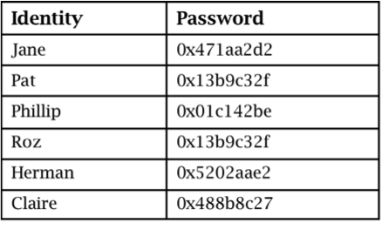
Password Storage
Plaintext
Concealed
Notes:
Passwords should never be stored in plaintext but rather should always be concealed. We talk more about proper password storage later.

Slide 7
Biometrics: Something You Are
Notes:
Handprints and fingerprints are two among many examples of biometrics.

Slide 8
Problems with Biometrics
Intrusive
Expensive
Single point of failure
Sampling error
False readings
Speed
Forgery
Notes:
Recent advances in smartphones have begun to make biometrics cheaper and easier to use. Biometrics are still inadequate for extremely sensitive applications, but their convenience makes them a great alternative to weak passwords.

Slide 9
Tokens: Something You Have
Notes:
An RSA SecurID with a code that changes every 60 seconds. Physical possession of the token should be necessary for successful authentication.

Slide 10
Federated Identity Management
Notes:
A federated identity management scheme is a union of separate identification and authentication systems. Authentication is performed in one place, and separate processes and systems determine that an already authenticated user is to be activated. Federated identity management is discussed in much greater detail in Chapter 8.

Slide 11
Single Sign-On
Notes:
Single sign-on lets a user log on once per session but access many different applications/systems. It often works in conjunction with federated identity management, with the federated identity provider acting as the source of authentication for all the applications.

Slide 12
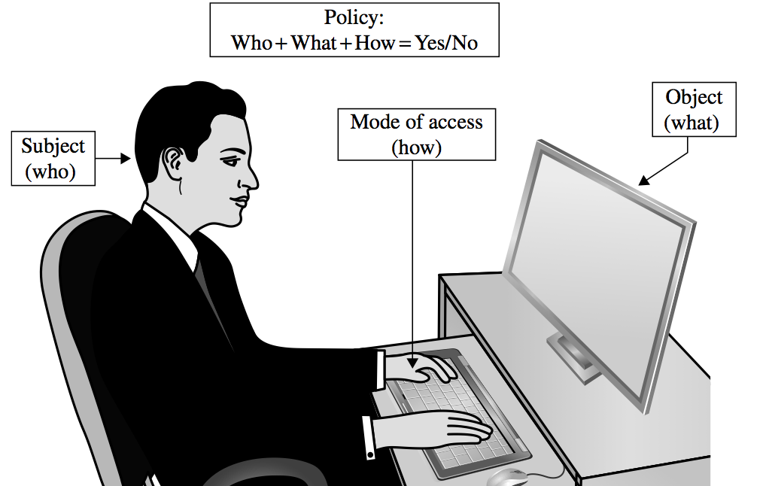
Access Control

Slide 13
Access Policies
Goals:
Check every access
Enforce least privilege
Verify acceptable usage
Track users’ access
Enforce at appropriate granularity
Use audit logging to track accesses

Slide 14
Implementing Access Control
Reference monitor
Access control directory
Access control matrix
Access control list
Privilege list
Capability
Procedure-oriented access control
Role-based access control
Notes:
Many of these items are shown in more detail in the following slides. Access control directories, matrixes, and lists are shown in self-explanatory visual representations.

Slide 15
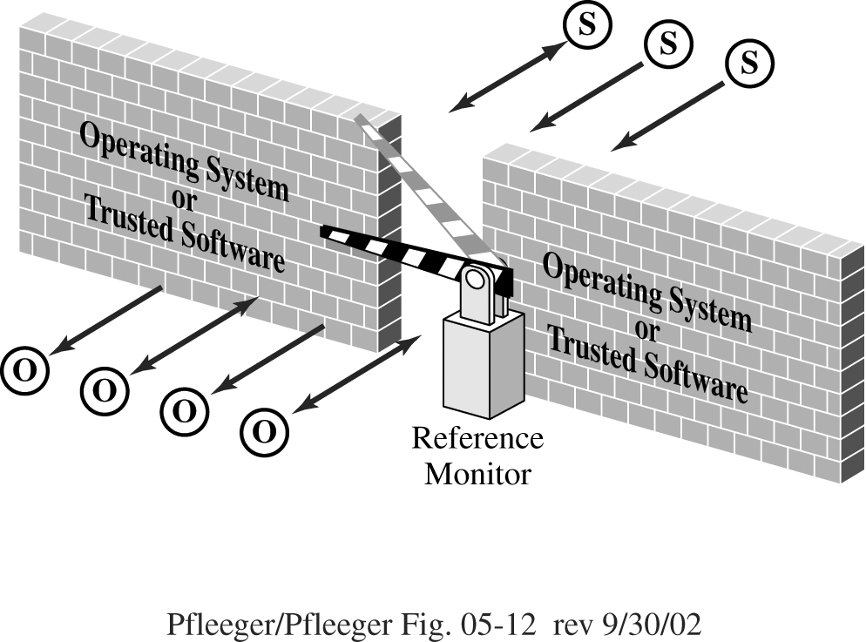
Reference Monitor
Notes:
A reference monitor is the primary access control enforcement mechanism of the operating system. It is discussed in more detail in Chapter 5.

Slide 16
Access Control Directory

Slide 17
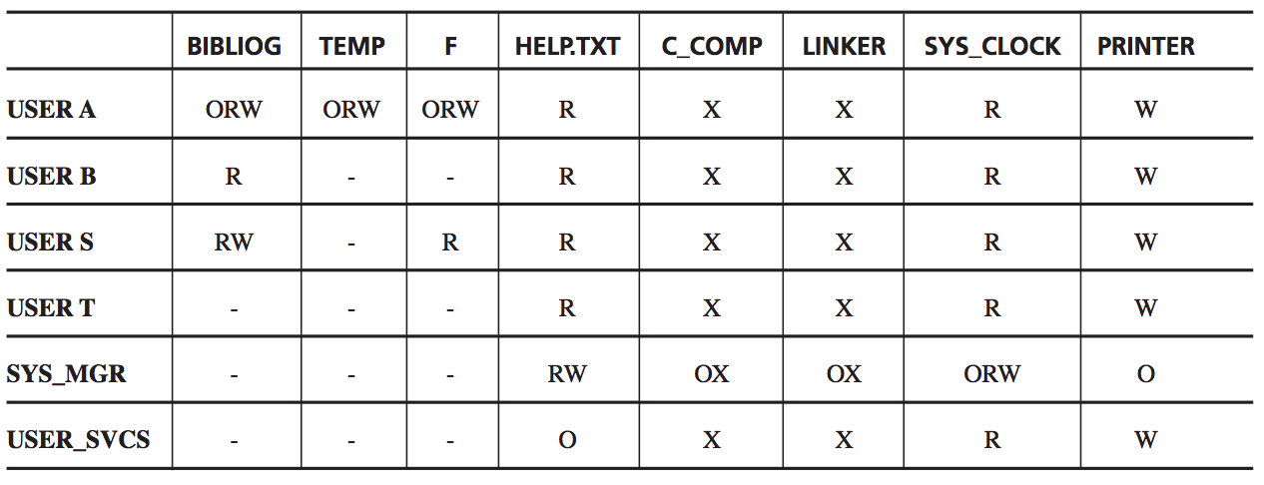
Access Control Matrix

Slide 18
Access Control List

Slide 19
Problems Addressed by Encryption
Suppose a sender wants to send a message to a recipient. An attacker may attempt to
Block the message
Intercept the message
Modify the message
Fabricate an authentic-looking alternate message

Slide 20
Encryption Terminology
Sender
Recipient
Transmission medium
Interceptor/intruder
Encrypt, encode, or encipher
Decrypt, decode, or decipher
Cryptosystem
Plaintext
Ciphertext

Slide 21
Encryption/Decryption Process
Notes:
The basic process of encrypting and then decrypting data.

Slide 22
Symmetric vs. Asymmetric
Notes:
The critical difference between symmetric and asymmetric is that symmetric uses a single key for both encryption and decryption, whereas asymmetric uses complementary keys.

Slide 23
Stream Ciphers
Notes:
In stream ciphers, each byte of the data stream is encrypted separately. This is as opposed to block ciphers, which are shown on the next slide.

Slide 24
Block Ciphers
Notes:
Unlike a stream cipher, a block cipher encrypts a group of plaintext symbols as a single block. The pros and cons of each model are discussed on the next slide.

Slide 25
Stream vs. Block

Slide 26
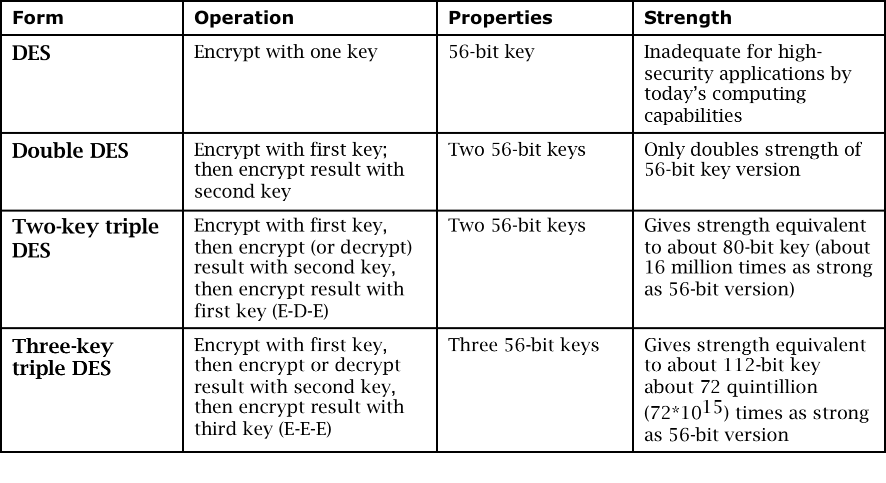
DES: The Data Encryption Standard
Symmetric block cipher
Developed in 1976 by IBM for the US National Institute of Standards and Technology (NIST)

Slide 27
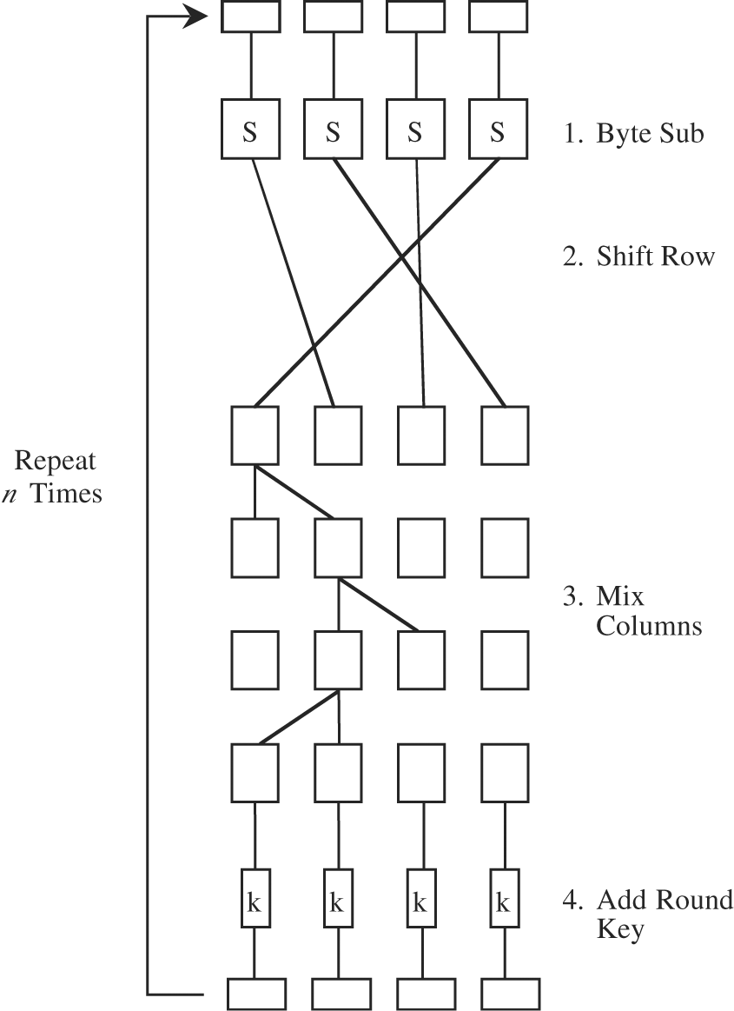
AES: Advanced Encryption System
Symmetric block cipher
Developed in 1999 by independent Dutch cryptographers
Still in common use

Slide 28
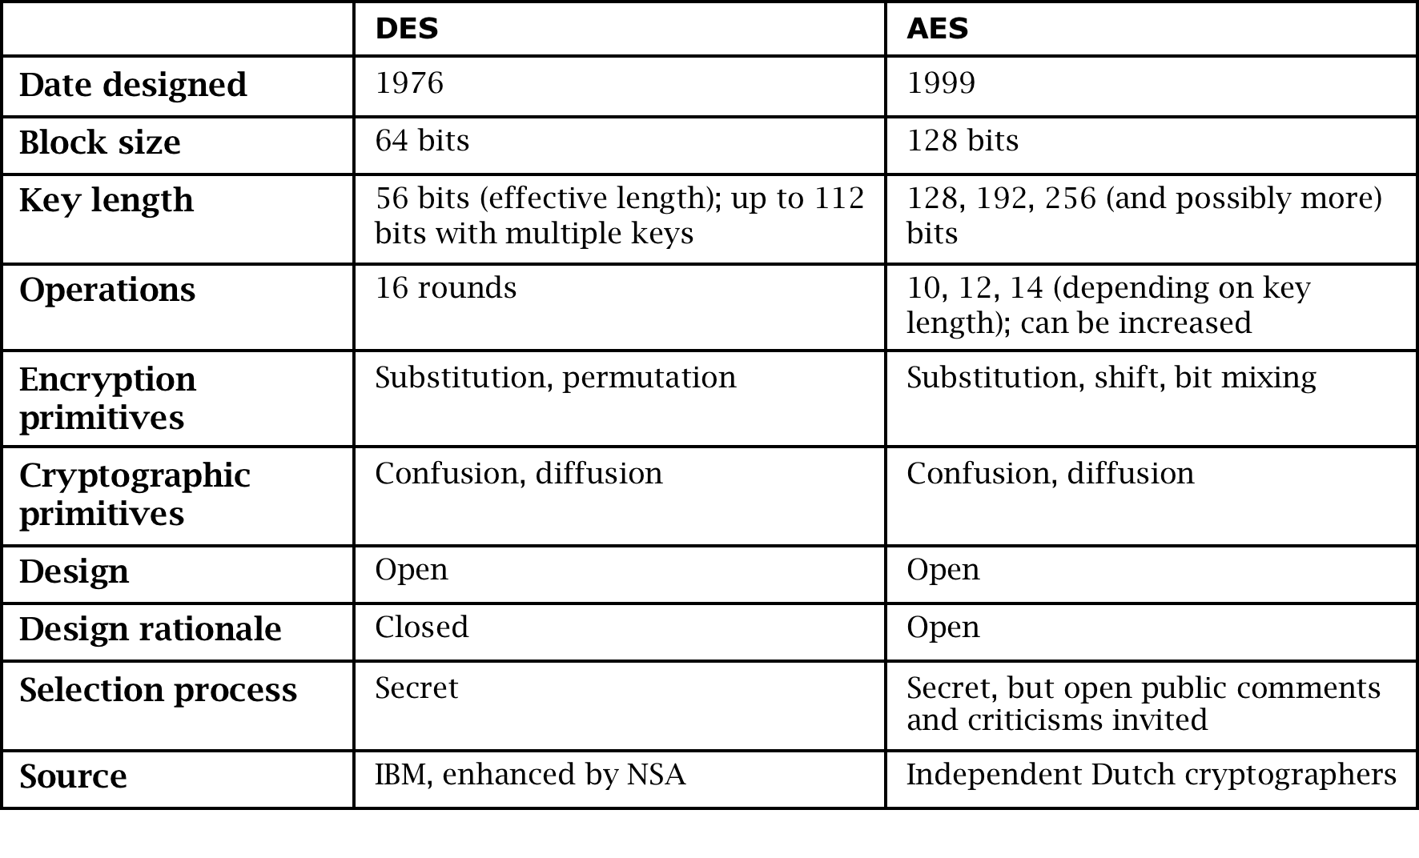
DES vs. AES
Notes:
AES has become the dominant symmetric encryption algorithm in use today. We discuss DES in this book both for historical purposes and because it is a relatively simple algorithm to use to explain how cryptographic primitives work.

Slide 29
Public Key (Asymmetric) Cryptography
Instead of two users sharing one secret key, each user has two keys: one public and one private
Messages encrypted using the user’s public key can only be decrypted using the user’s private key, and vice versa

Slide 30
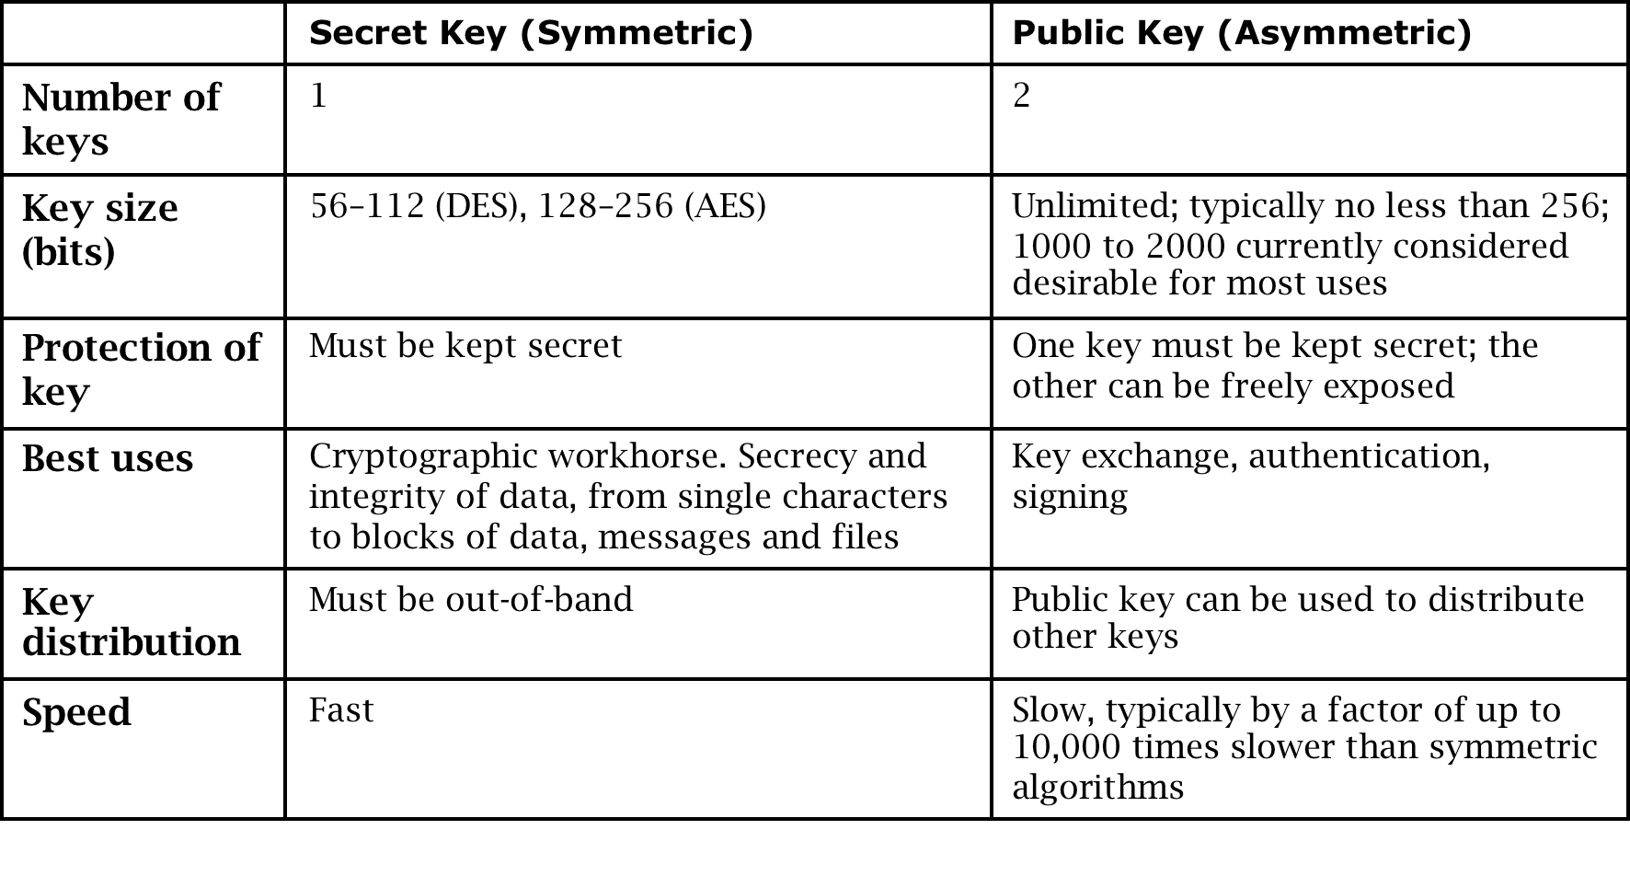
Secret Key vs. Public Key Encryption
Notes:
Symmetric and asymmetric algorithms have complementary strengths and weaknesses and are therefore used both for different purposes and in concert with each other.

Slide 31
Public Key to Exchange Secret Keys
Notes:
This is a great example of asymmetric and symmetric encryption being used together. We need asymmetric to perform the initial exchange securely, but thereafter we can benefit from the speed of a symmetric algorithm.

Slide 32
Key Exchange Man in the Middle
Notes:
This exchange is the same as on the previous slide, but with an attacker in the middle. This attack can be defeated using the simple tweak described on pp. 107–108 of the textbook. This is an interesting problem to have students brainstorm or work on for homework.

Slide 33
Error Detecting Codes
Demonstrates that a block of data has been modified
Simple error detecting codes:
Parity checks
Cyclic redundancy checks
Cryptographic error detecting codes:
One-way hash functions
Cryptographic checksums
Digital signatures

Slide 34
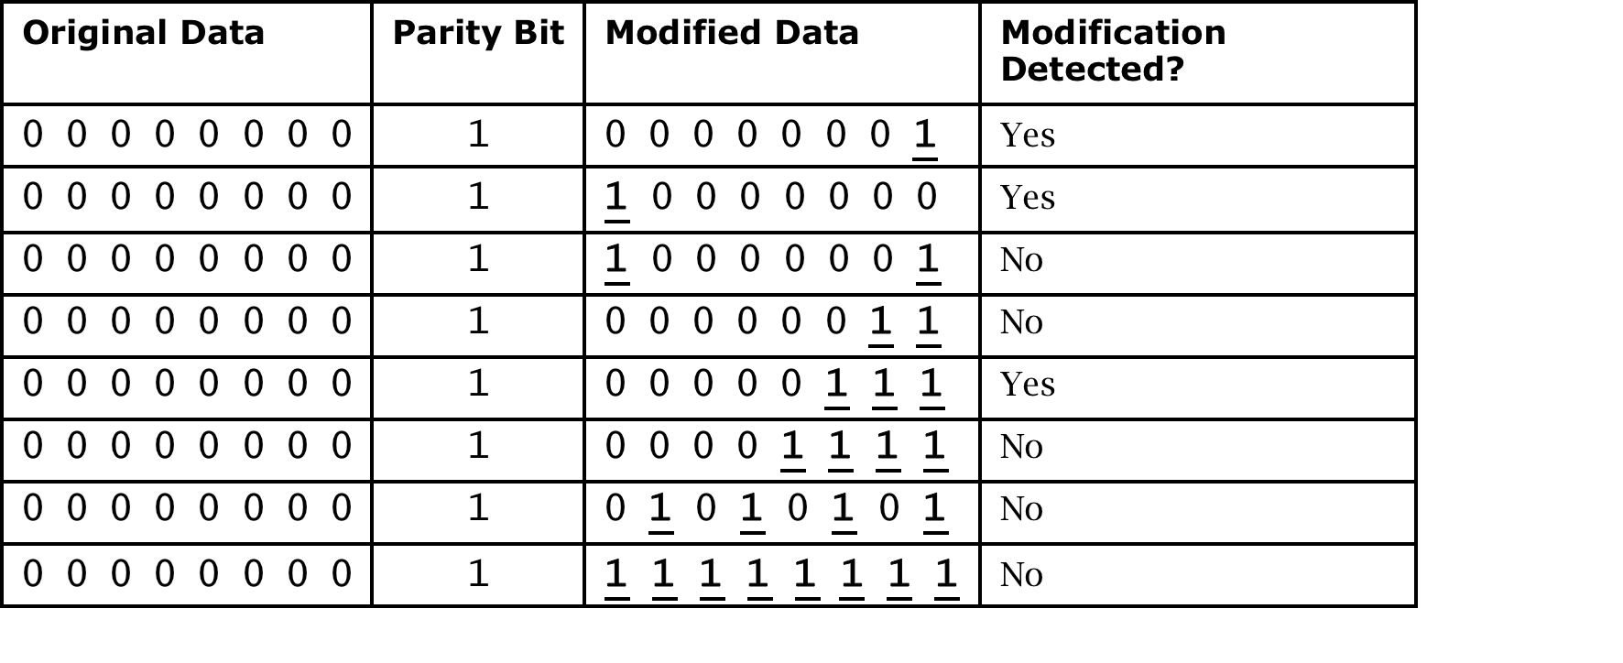
Parity Check

Slide 35
One-Way Hash Function

Slide 36
Digital Signature

Slide 37
Certificates: Trustable Identities and Public Keys
A certificate is a public key and an identity bound together and signed by a certificate authority.
A certificate authority is an authority that users trust to accurately verify identities before generating certificates that bind those identities to keys.

Slide 38
Certificate Signing and Hierarchy
Notes:
Diana’s certificate is made using Edward’s signature. Delwyn’s certificate includes Diana’s certificate so that it can effectively be tied back to Edward, creating a chain of trust.

Slide 39
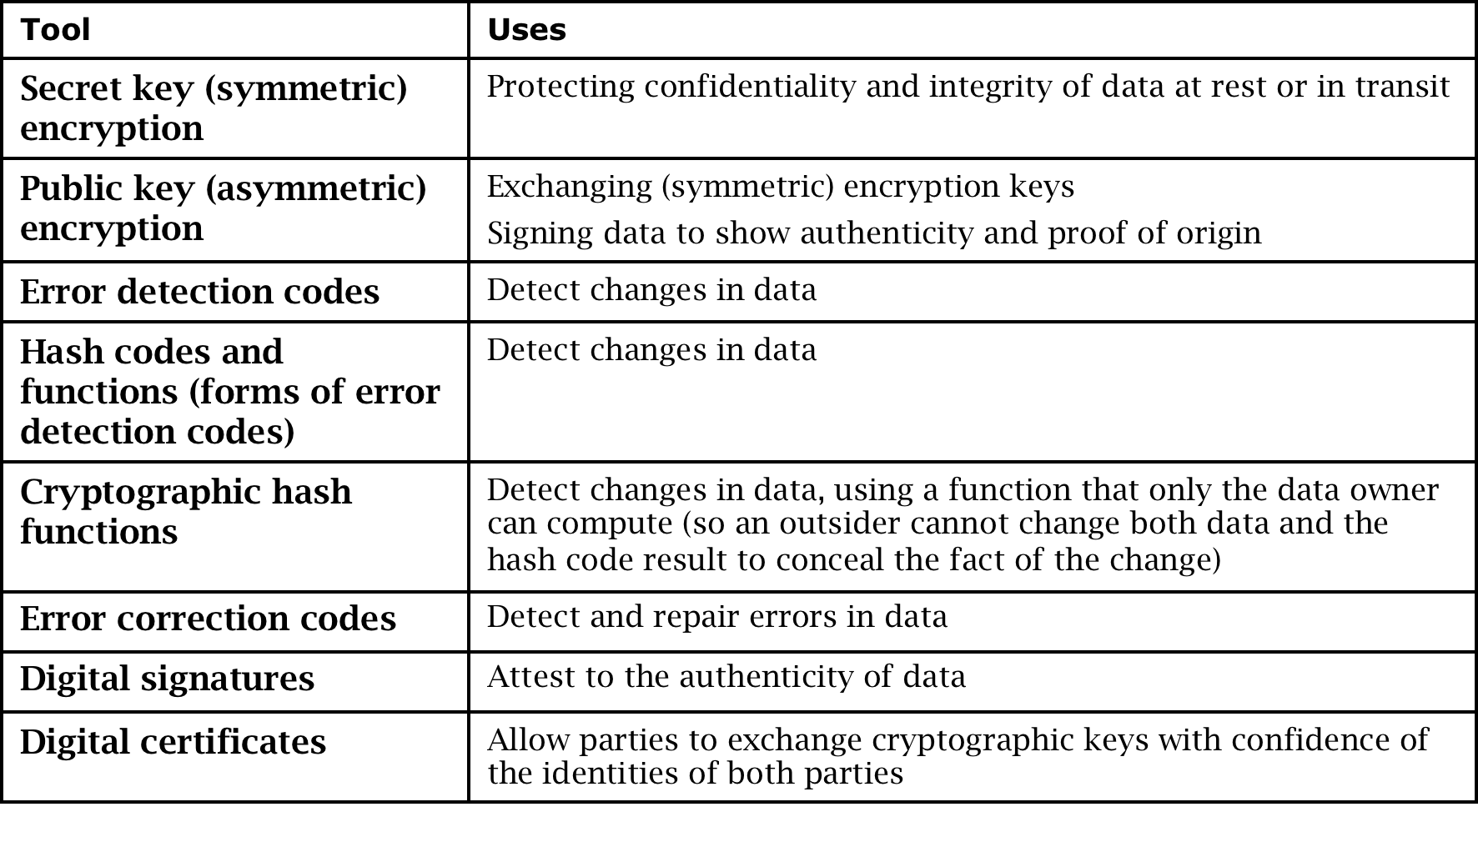
Cryptographic Tool Summary

Slide 40
Summary
Users can authenticate using something they know, something they are, or something they have
Systems may use a variety of mechanisms to implement access control
Encryption helps prevent attackers from revealing, modifying, or fabricating messages
Symmetric and asymmetric encryption have complementary strengths and weaknesses
Certificates bind identities to digital signatures

